Slide 1
London’s changing workforce Employee jobs by nationality
Ammar Ljubijankić Kutasi, GLA Economics

Slide 2
Introduction
The analysis is based on payrolled employee data by nationality from HMRC.
We find:
Jobs held by non-EU nationals has risen markedly since 2021 while EU-national-held jobs stagnated
London continues to have a much larger non-UK workforce relative to the rest of the UK
Non-UK nationals are vital in certain London industries, such as Hospitality and Health
Notes:
When we talk about nationality here, we refer to three general and exclusive groups: UK nationals, EU nationals, and non-EU nationals. The nationality is reported when applying for a national insurance number, so it is possible the nationality may changer afterwards.
It excludes self-employed workers (around 11% of jobs in London)

Slide 3
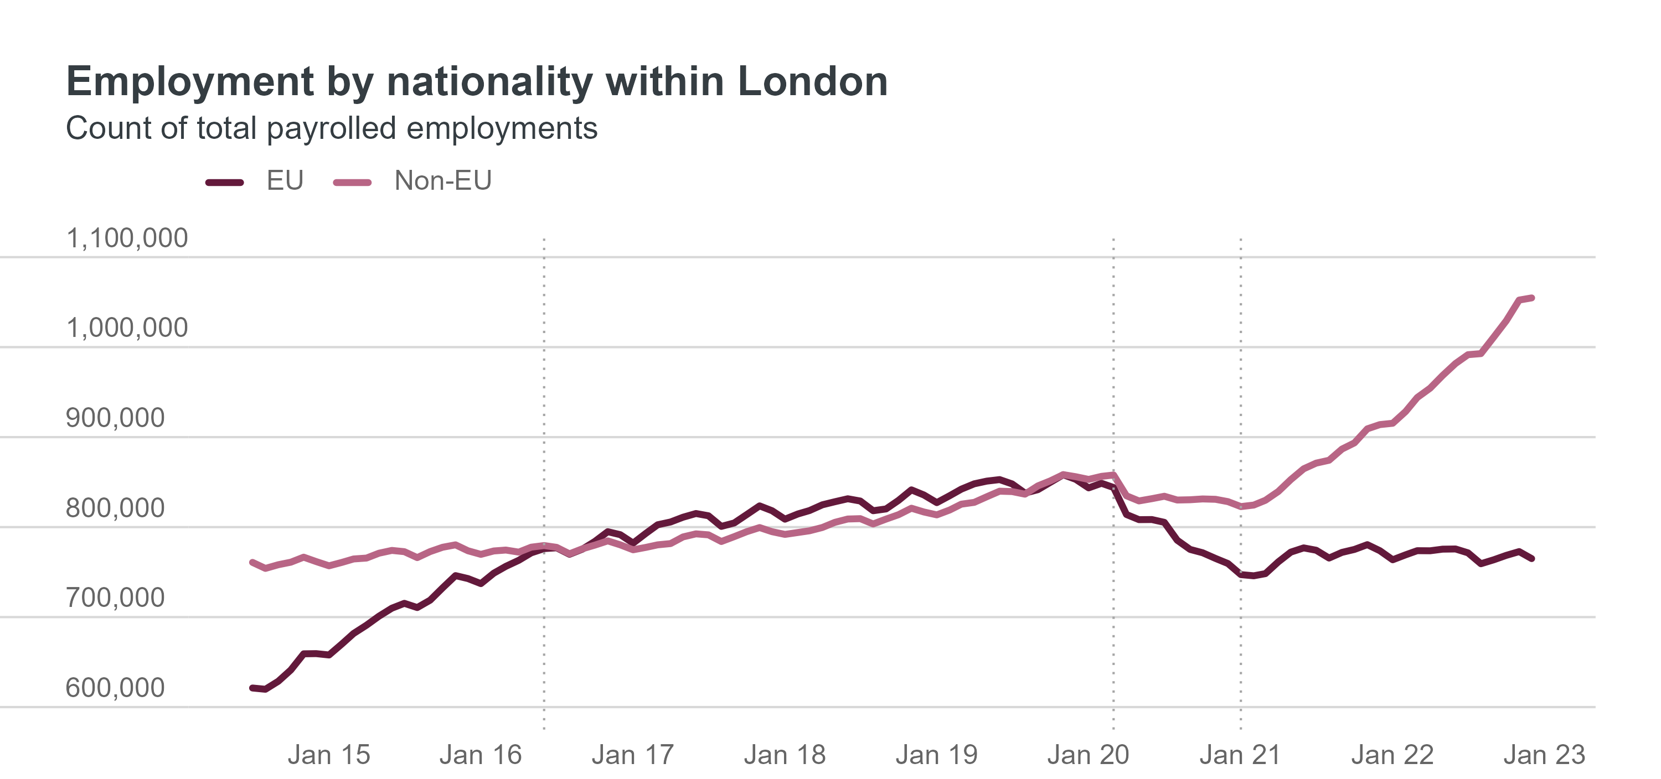
Non-EU workers lifted London’s labour market as number of EU workers decreased
Source: HM Revenue and Customs – Pay As You Earn Real Time Information (non-seasonally adjusted) and Migrant Worker Scan. Note: Estimates are based on where employees live. Vertical lines indicate Brexit vote of June 2016, beginning of lockdowns in March 2020, and end of free movement in January 2021, respectively.
Notes:
The first thing to note is the overall trend, and here we have a very clear picture. Before the Brexit vote in mid-2016, the number of EU workers in London was on the increase while the number of non-EU workers was relatively stable. In the following four years, the number of employments held by the two groups was about the same, around the 800k mark, as the growth for EU nationals stopped. As covid hit and lockdowns shook the labour market, we overall decreases for all groups, including for UK workers (not seen in this chart).
However, the trends really diverged after that, in particular from 2021 onwards. This was the year where the new immigration schemes for foreign workers began, which made it significantly more difficult for EU nationals to arrive and work in the UK. As a result, their numbers fell below 2016 levels.
Note on employments: At this point I would like to compare employments, or employee jobs, with actual number of employees. We use employments simply because that data allows to look at industries, but there is a slight difference compared to number of employees. Specifically, individuals may hold more than one job.

Slide 4
Non-EU workers tend to have more employments than other nationalities
Source: HM Revenue and Customs – Pay As You Earn Real Time Information (non-seasonally adjusted) and Migrant Worker Scan. Note: Estimates are based on where employees live. Vertical lines indicate Brexit vote of June 2016, beginning of lockdowns in March 2020, and end of free movement in January 2021, respectively.
Notes:
On this chart, we compared the average number of jobs per employee by nationality. The differences are not massive, but it does show that non-EU workers tend to hold more jobs than other nationalities, and this gap actually grew from 2021 onwards. This means that some of the growth we saw in the previous slide is due to non-EU workers increasingly having more jobs than other nationals, but looking at the big picture, the trends remain the same: the number of EU workers has fallen while the number of non-EU workers is growing.
Chart is based on NSA employments vs. NSA employees. Non-EU have more employments throughout and especially from 2020 onwards, which means their growth in employment share happens faster

Slide 5
What may have caused the shift from EU to non-EU workers?
No free movement for EU workers - Skilled Worker visas now required for most
Excludes many low-wage jobs, especially in hospitality
Special exceptions exist for e.g. health and care workers
Increase in Non-EU employments unclear
May be due to people already in the UK beforehand rather than new immigrants
As EU and non-EU workers both require visas, pool of workers is larger outside EU
Other European countries also experienced tight labour markets
Coinciding with pandemic emigrations make conclusions difficult
Source: Migration Observatory, “How is the End of Free Movement Affecting the Low-wage Labour Force in the UK?”
Notes:
Apart from not being allowed to freely enter UK for work, EU nationals have less rights in terms of changing jobs and general welfare benefits
MO claims that non-EU workers were more in high skills (using 2021 data) so not substituting for low-wage EU workers
Is it possible that more employers have begun hiring non-EU nationals in intermediate-skills occupations? MO charts suggested not back in Jan 2021, but may have changed since as employers become used to system (ASK)
Mention industries with smaller firms suffering (e.g. transportation and construction) losing out due to admin costs of visas for low skill workers (Portes 2022)

Slide 6
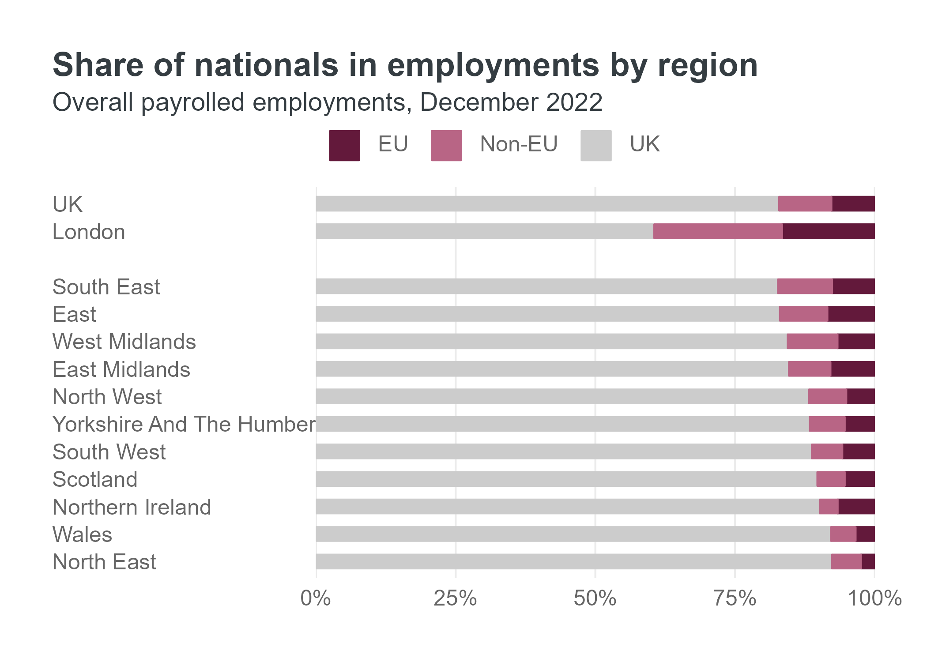
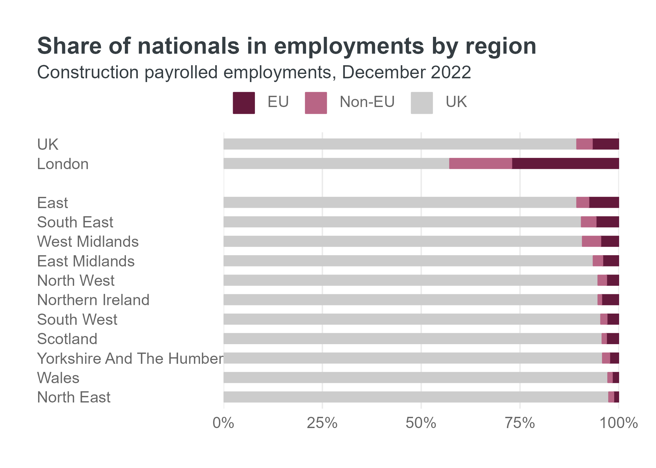
London’s share of non-UK workforce is 2-4 times higher than UK average
Source: HM Revenue and Customs – Pay As You Earn Real Time Information (non-seasonally adjusted) and Migrant Worker Scan. Note: Estimates are based on where employees live.
Notes:
Comparing London with the rest of the UK overall and the other regions and countries, we see (perhaps unsurprisingly) that non-UK workers are a much larger part of London’s labour market than elsewhere. The chart to the left shows the overall picture across industries, where the distinction is already clear: Around 40% of London’s employments are held by non-UK workers, but less than 20% of all UK employments. So more than twice as many in London
But within the construction industry, the difference is even larger: again more than 40% of employments in London, but around 10% in UK overall: more than four times as many employments held by non-UK workers!
Shows the difference in the labour market dynamics in London vs. the rest of UK, and shows how much more sensitive employers in London may be to policy changes impacting their ability to attract workers from abroad.
Overall, London has (16.6+22.9)=39.5% while UK has (7.8+9.3)=17.1%, so 2.3 times higher. In construction, it is 42.7% vs. 10.6%, so 4 times higher.

Slide 7
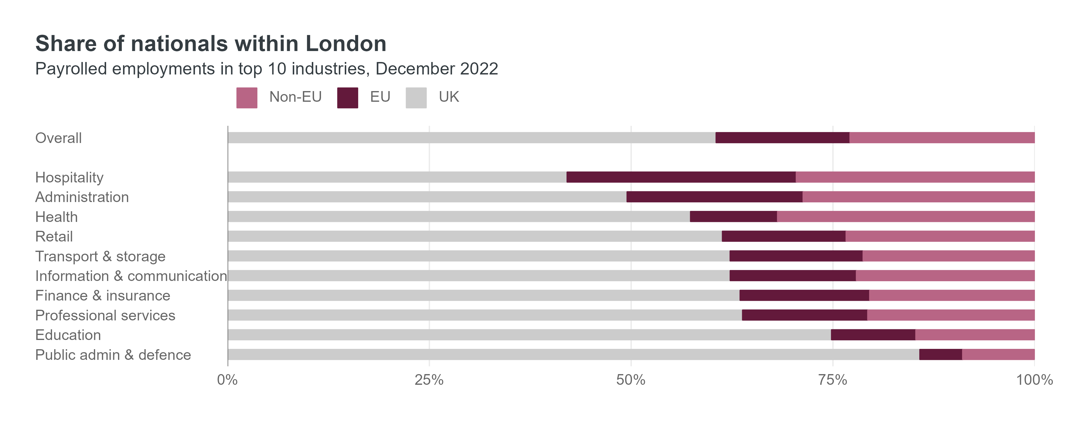
More than half of employments held by non-UK workers in Hospitality and Administration
Source: HM Revenue and Customs – Pay As You Earn Real Time Information (non-seasonally adjusted) and Migrant Worker Scan. Note: Estimates are based on where employees live.
Notes:
Within London, some industries are more reliant on non-UK workers than others. This chart shows the share of employments by nationality in December 2022, and hospitality and administration had particularly high shares, with more than 50% of employments held by non-UK workers, followed by health and retail. While this shows how some industries are more vulnerable to the departure of foreign nationals, we should keep in mind that all these industries still have more non-UK workers than the same industries in the rest of the UK.
It is still interesting to see how the general trends we have already seen unfolded within industries over time (next slide)

Slide 8
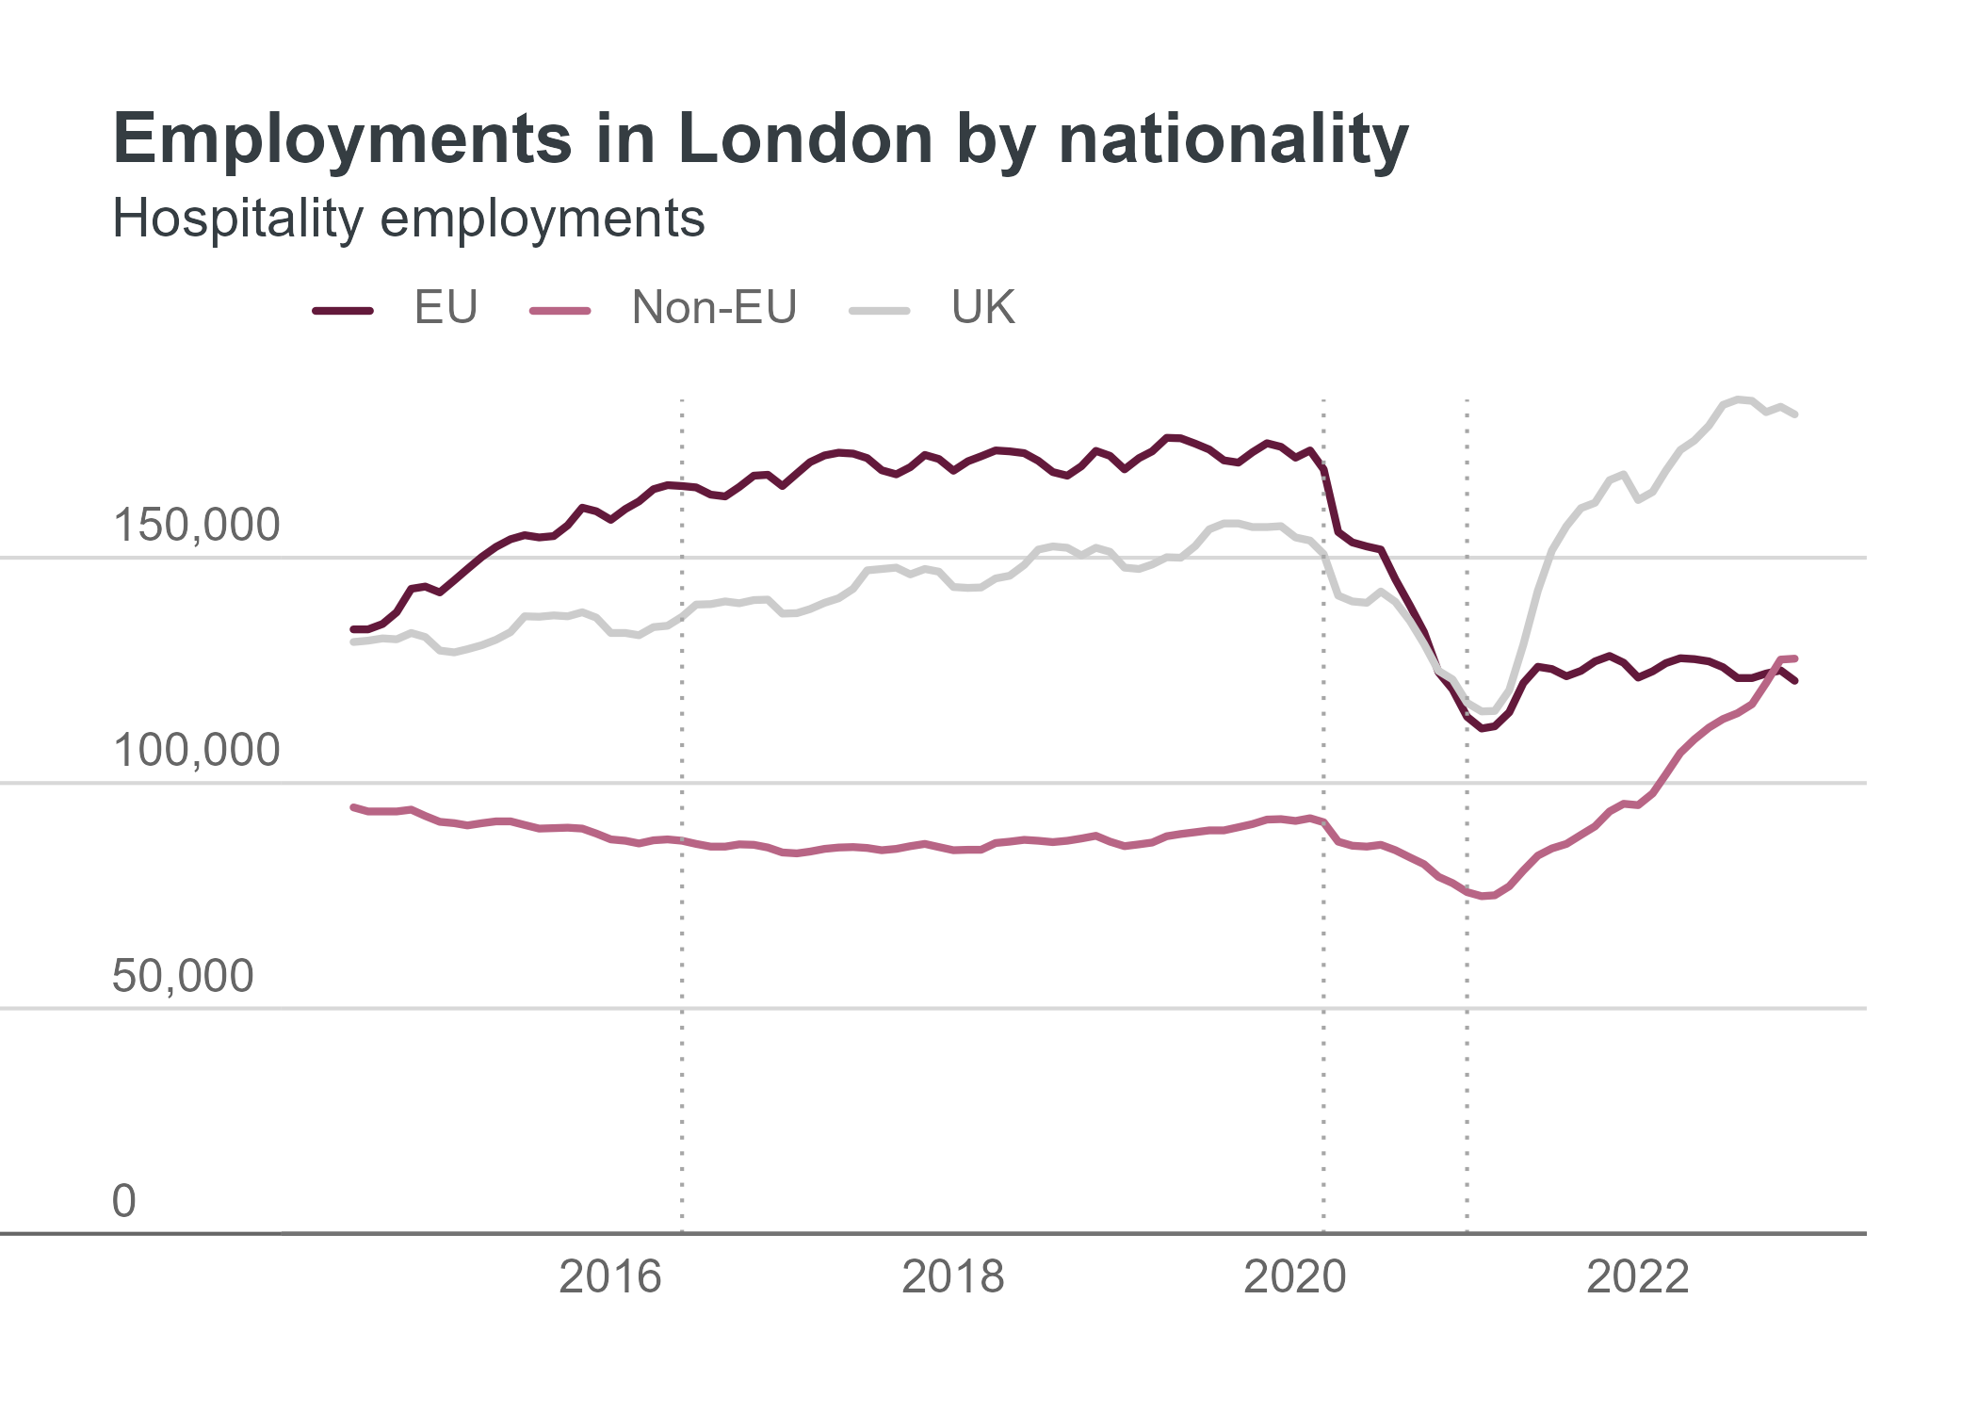
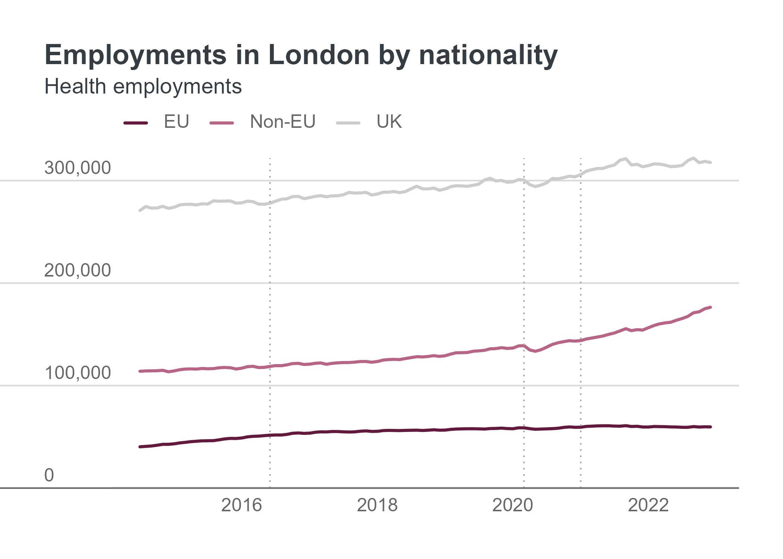
Hospitality saw huge shifts, while Health has been less impacted
Source: HM Revenue and Customs – Pay As You Earn Real Time Information (non-seasonally adjusted) and Migrant Worker Scan. Note: Estimates are based on where employees live. Vertical lines indicate Brexit vote of June 2016, beginning of lockdowns in March 2020, and end of free movement in January 2021, respectively.
Notes:
Here we focus on hospitality and health –among the two largest sectors in London by employee counts, but two which show very different trends.
Hospitality: is the sector with the clearest volatility in employment counts, since EU nationals actually made up the largest share for the entire pre-2020 period we have data for. In the aftermath of the pandemic and Brexit, the sector recovered its previous size through an increase in both non-EU workers but in particular due to UK workers, to a much larger extent than we’ve seen in other sectors.
Health: was very different. Employments held by Non-EU nationals consistently outnumbered EU nationals by around 2:1, so there was not a large loss from EU nationals. Instead, the number of non-EU workers has continued to rise
The difference between these two sectors likely reflect two things
1) the lockdowns meant that many jobs within customer-facing sectors within hospitality were furloughed or closed entirely, leading to a large decline overall, while jobs within health continued to be more important than ever.
2) hospitality jobs are much less likely to qualify for skilled worker visas, as they tend to be low-paid and small businesses would be unlikely to face the large administrative costs in applying for visas. Meanwhile, health has many skilled jobs, and even for lower-skilled jobs there is preferential treatment as it is considered a vital industry by the government.

Slide 9
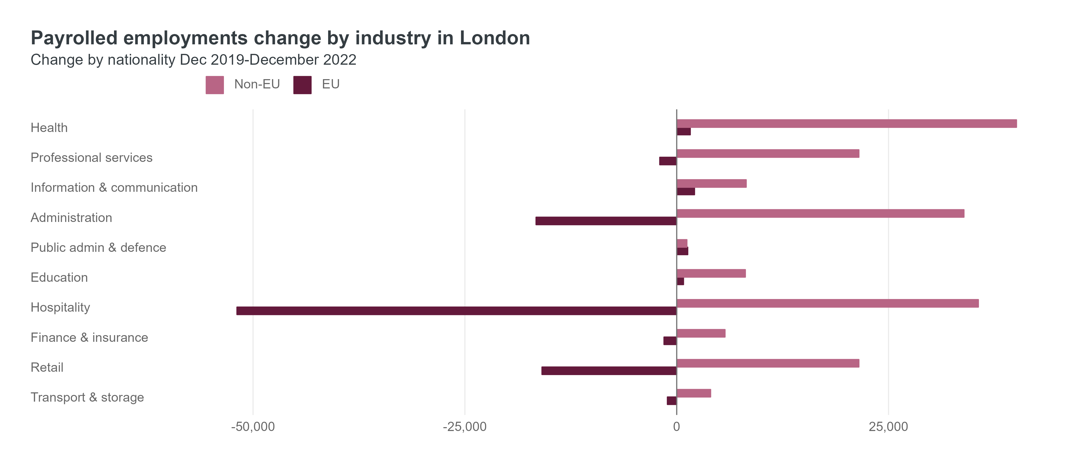
Replacement by nationality was not uniform across sectors
Source: HM Revenue and Customs – Pay As You Earn Real Time Information (non-seasonally adjusted) and Migrant Worker Scan. Note: Estimates are based on where employees live. Top ten sectors by employee count, ranked by overall increase in employees.
Notes:
Finally, on the question whether non-EU workers have replaced EU workers “like-for-like”, this does not seem to be the case. These are the ten largest industries in London showing the change in employments in the three years from December 2019 to December 2022. what is immediately clear is that the length of the light and dark pink bars do not generally cancel each other out, which would be the case if a EU held job was replaced by a non-EU held job.
Instead, hospitality is again the outlier with a huge drop in EU employments, but a smaller rise in non-EU employments. As we already saw, UK nationals also contributed to some of the recovery.
In most other industries, the gain in non-EU employments outpaced the loss in EU employments.

Slide 10
Thank you
For more, see our analysis on the Datastore
Questions and discussion
- with Denis Kierans from the Migration Observatory

Slide 11
Additional charts

Slide 12
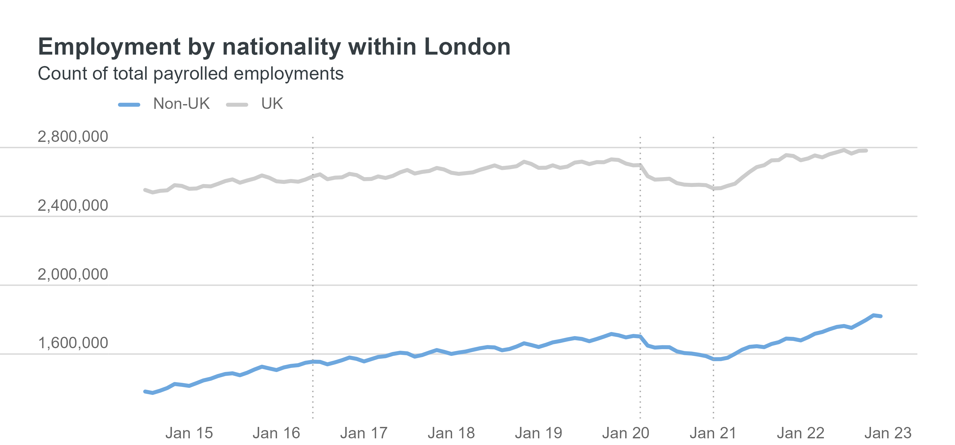
Number of employments, overall UK and non-UK
Source: HM Revenue and Customs – Pay As You Earn Real Time Information (non-seasonally adjusted) and Migrant Worker Scan. Note: Estimates are based on where employees live. Vertical lines indicate Brexit vote of June 2016, beginning of lockdowns in March 2020, and end of free movement in January 2021, respectively.

Slide 13
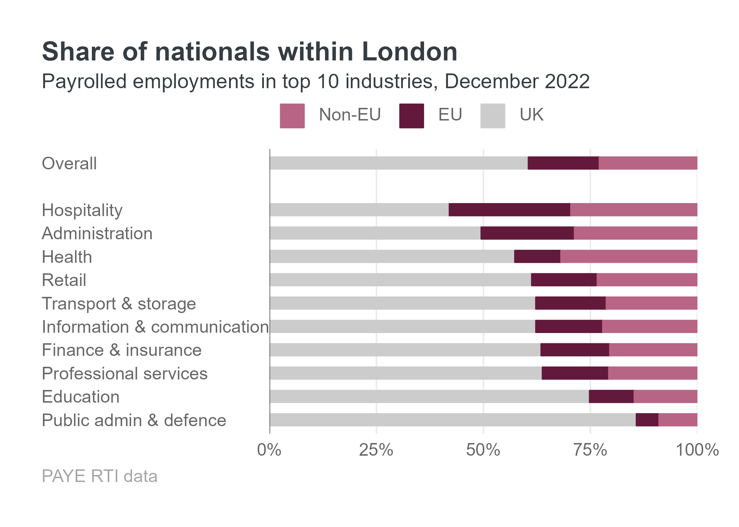
Share by nationality in London, by industry
Source: HM Revenue and Customs – Pay As You Earn Real Time Information (non-seasonally adjusted) and Migrant Worker Scan. Note: Estimates are based on where employees live. Top ten sectors by employee count, ranked by overall increase in employees.

Slide 14
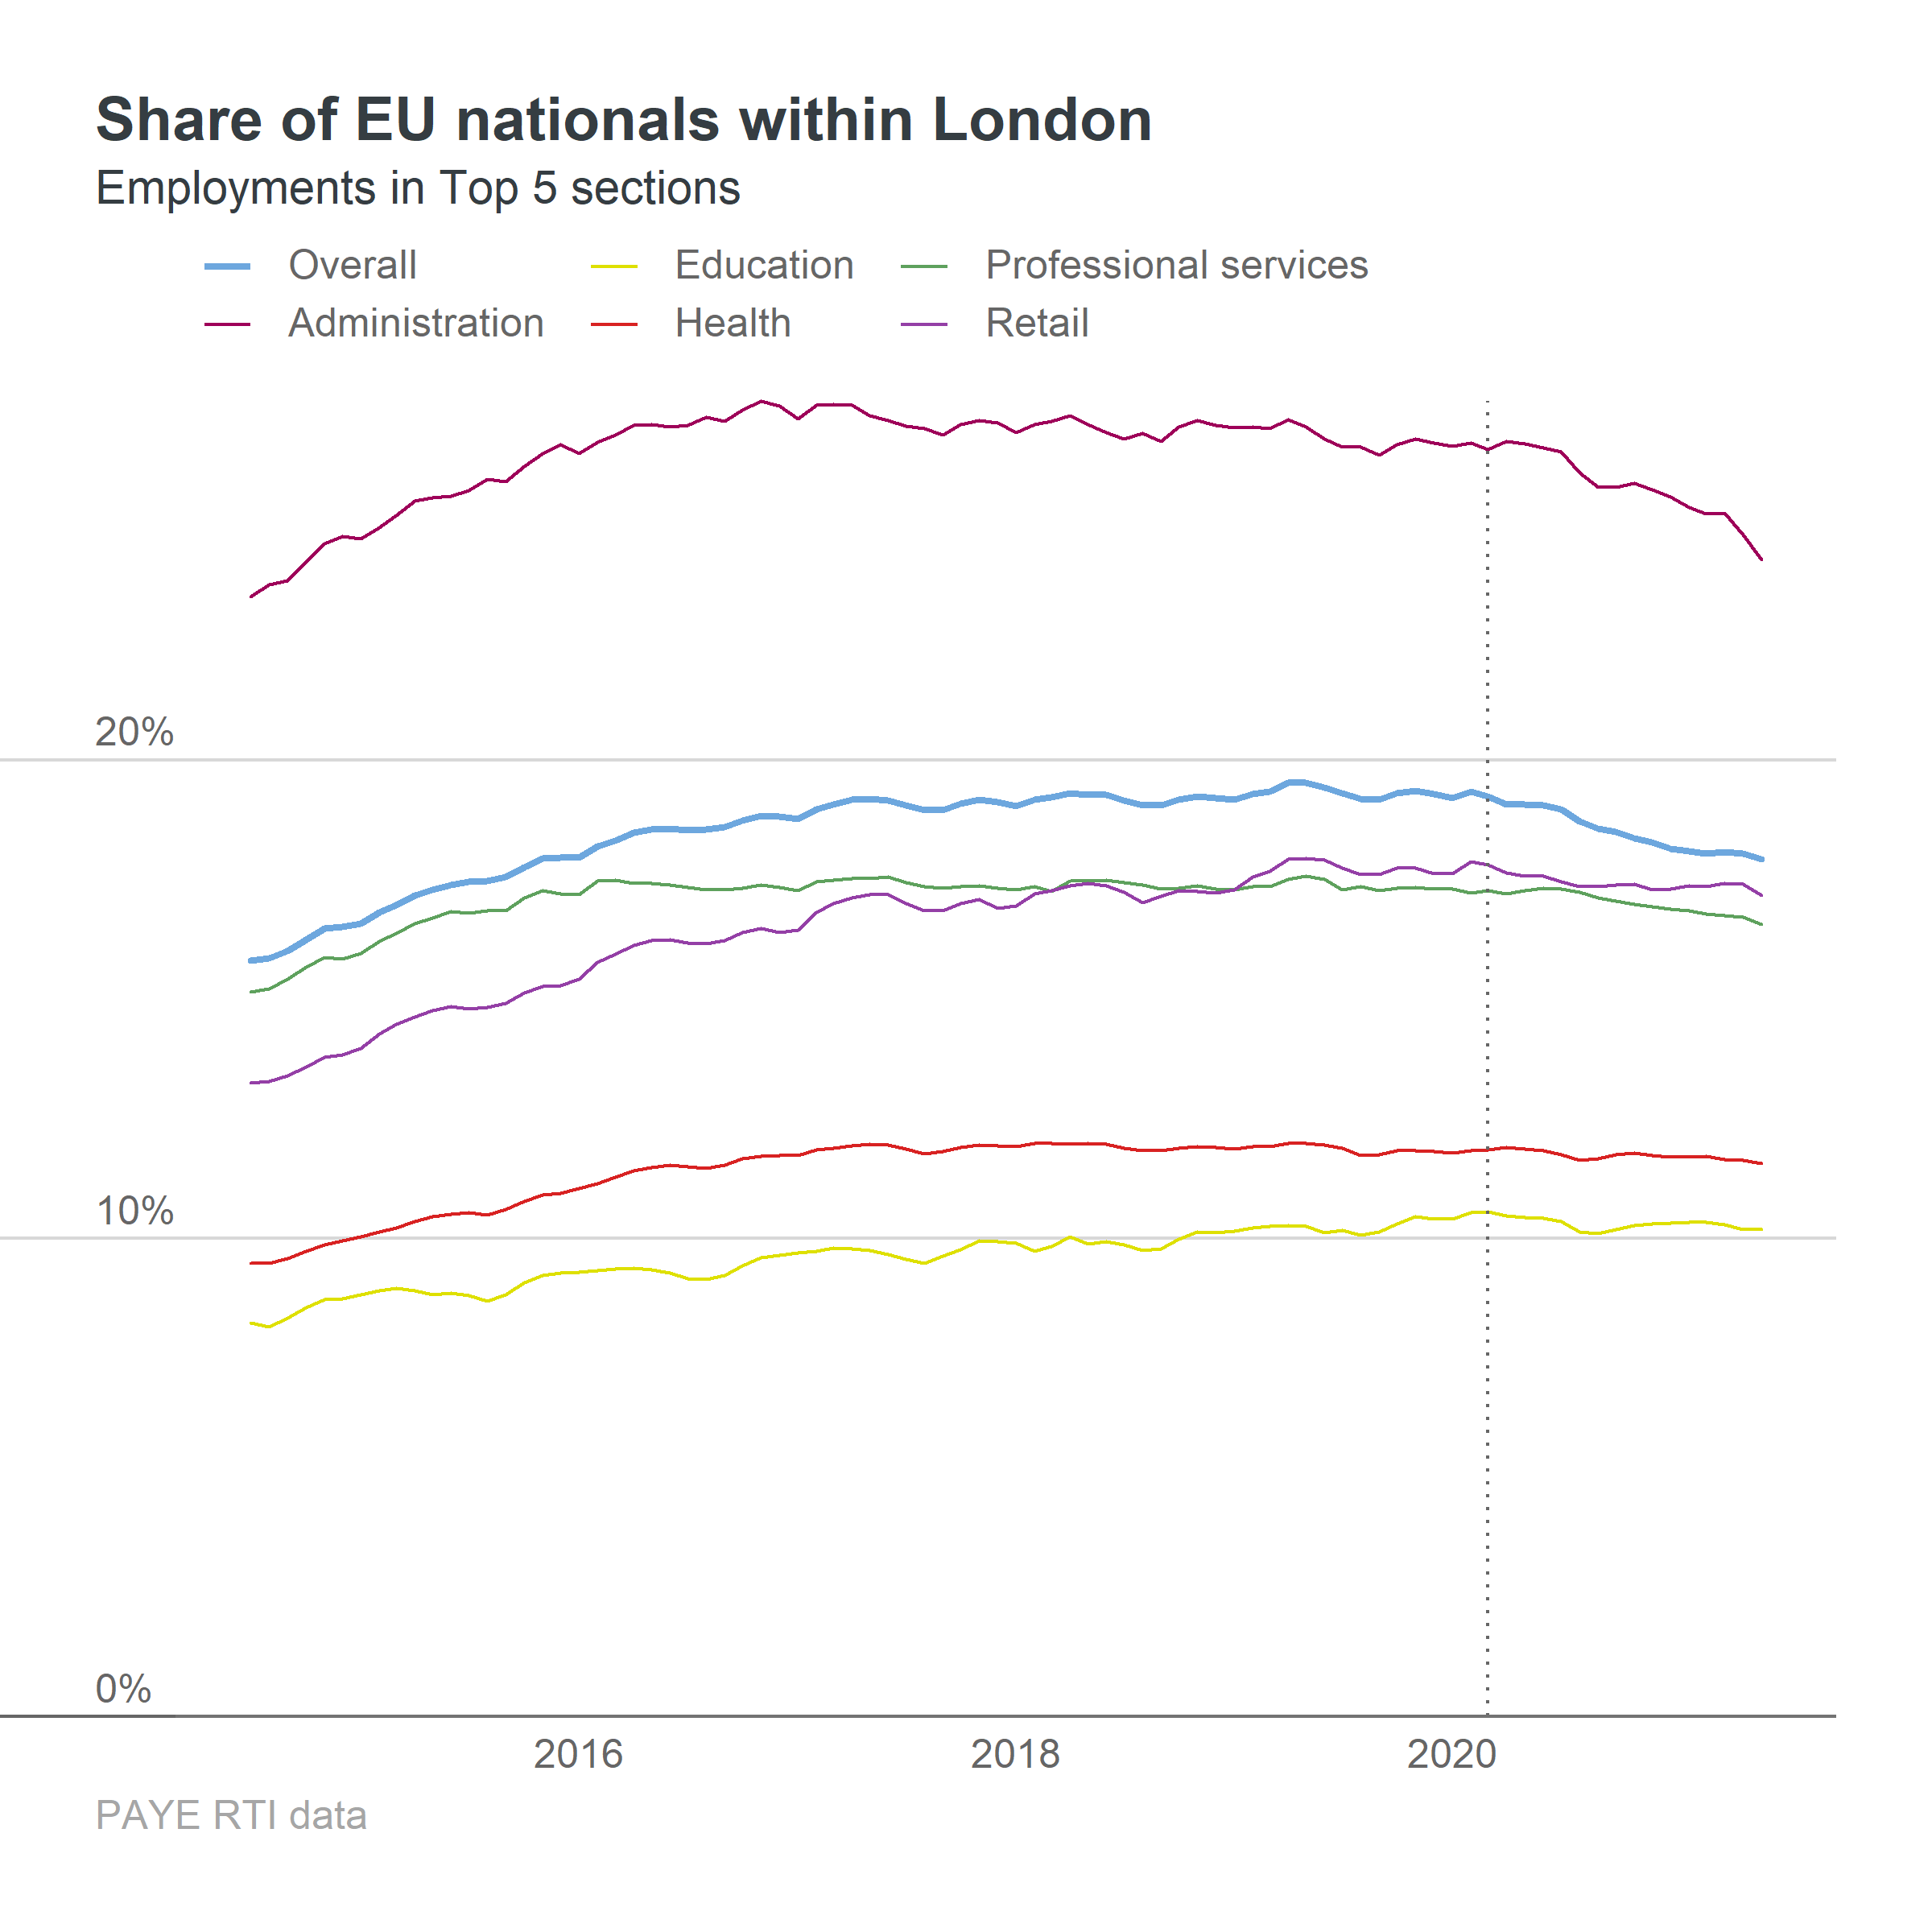
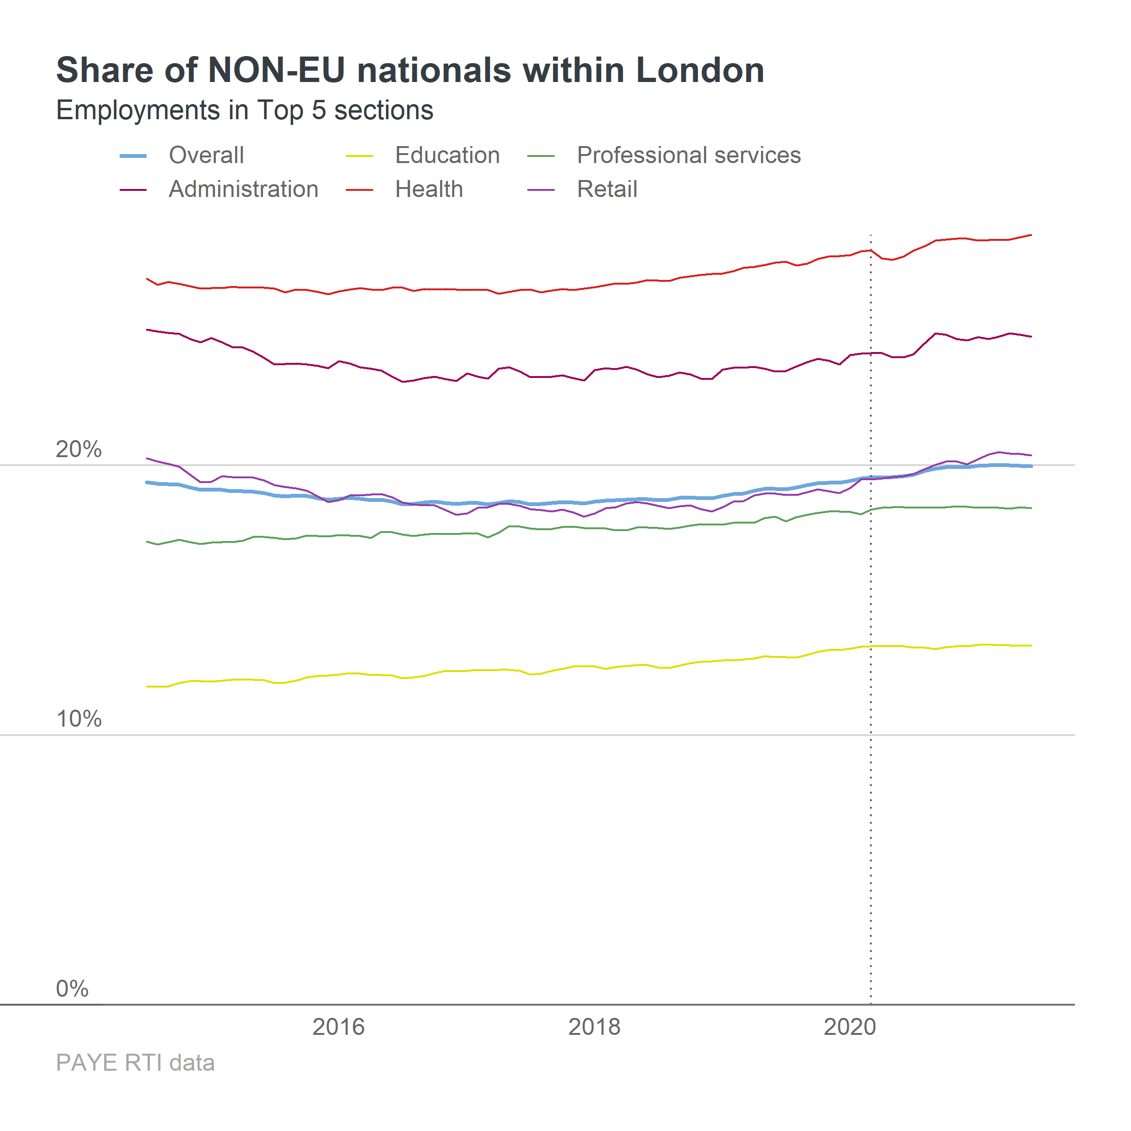
Share of nationality group within London, time trend
Source: HM Revenue and Customs – Pay As You Earn Real Time Information (non-seasonally adjusted) and Migrant Worker Scan. Note: Estimates are based on where employees live. Vertical lines indicate Brexit vote of June 2016, beginning of lockdowns in March 2020, and end of free movement in January 2021, respectively.

Slide 15
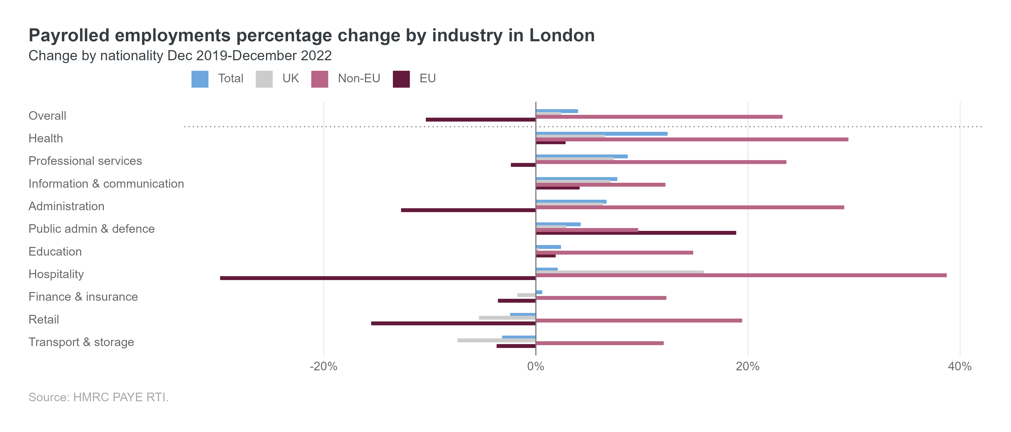
Change in all industries since Dec 2019, percentages
Source: HM Revenue and Customs – Pay As You Earn Real Time Information (non-seasonally adjusted) and Migrant Worker Scan. Note: Estimates are based on where employees live. Top ten sectors by employee count, ranked by overall increase in employees.
Notes:
Try adding it with numbers and only keeping EU and non-EU

